Slide 1


Slide 2

Artifical Intelligence
Job Interview Analyzer
(AI Based)

Slide 3



Presented By:
Muhammad Ali
Student ID: 233510
Muhammad Hassan
Student ID: 233516

Slide 4
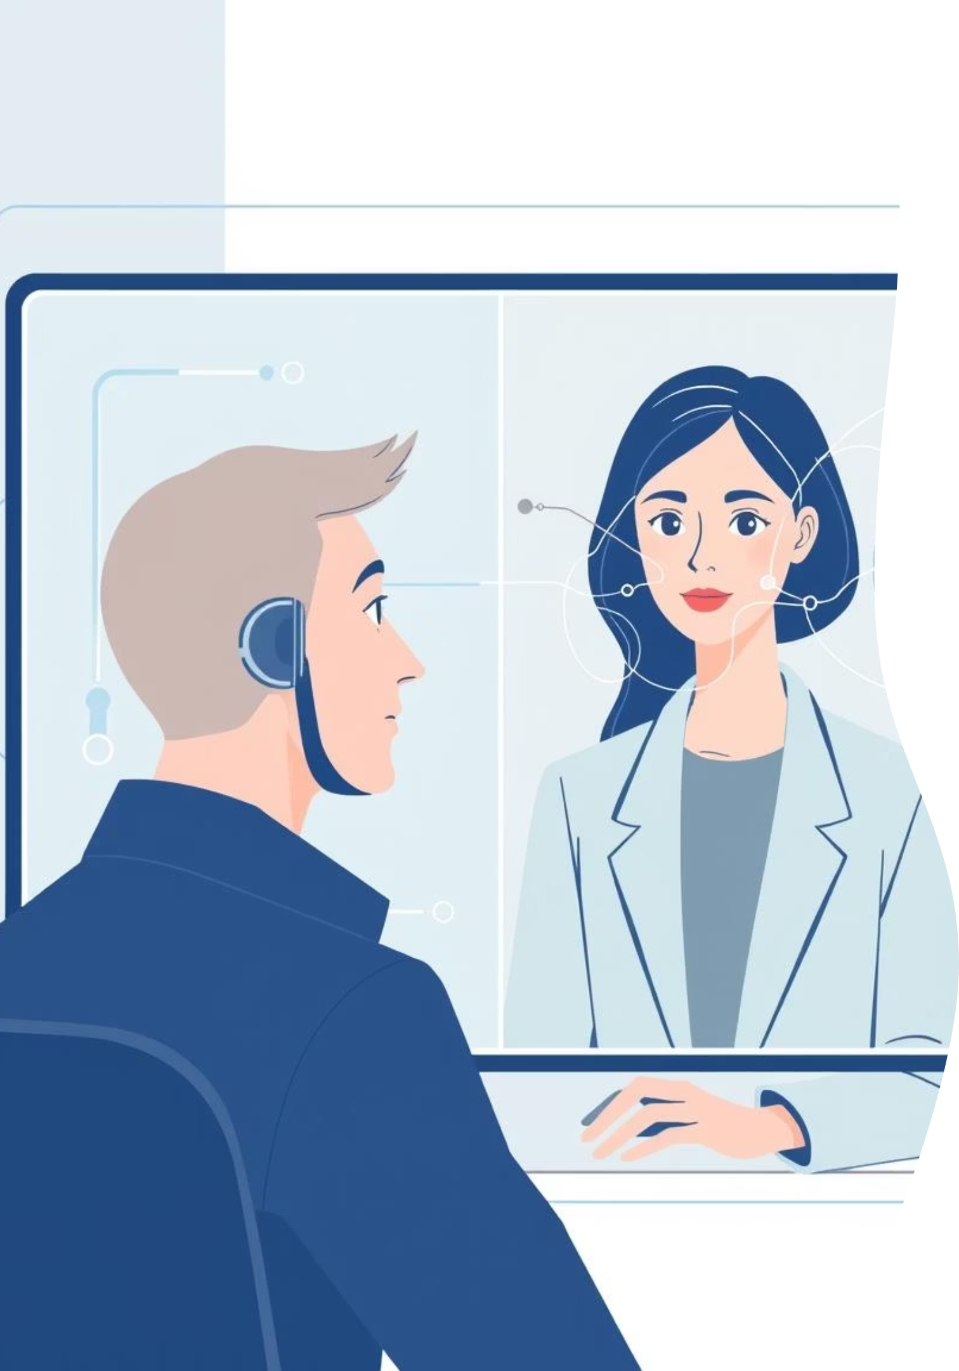

AI-Based Job Interview Analyzer
The AI Interview Analyzer is a real-time, AI-powered system that evaluates interview performance using multimodal emotion recognition. It combines Facial Emotion Detection and Speech Emotion Recognition to provide objective feedback.
This system addresses the lack of objective feedback and professional coaching in the competitive job market by leveraging deep learning and computer vision. It captures video and audio, processes them with neural networks, and generates detailed reports with actionable recommendations.

Slide 5
Problem Statement: Subjectivity in Interview Evaluation
Traditional interview evaluations are subjective and prone to human bias. Candidates often lack objective feedback on crucial communication aspects:
Lack of Objective Feedback
Non-verbal Gaps
Emotional State
Assessments are inconsistent and subjective.
Candidates are unaware of their facial expressions or body language.
Nervousness and anxiety are hard to self-assess.
Speech Patterns
Limited Coaching
Voice emotions impact outcomes but are hard to evaluate in real-time.
Professional services are expensive and inaccessible.
This project aims to provide automated, AI-based, objective, real-time feedback on facial expressions and speech emotions.

Slide 6
Project Objectives
Our primary goals are to develop a comprehensive AI interview analysis system:
1
Real-time Facial Emotion Detection
Implement deep learning for 7 emotion classifications (FER2013 dataset).
2
Speech Emotion Recognition
Integrate Wav2Vec2 model for speech pattern emotion analysis.
3
Multimodal Fusion System
Combine facial and speech analysis with weighted scoring for evaluation.
4
Eye Contact Tracking
Monitor and measure eye contact using face detection landmarks.
5
Comprehensive Reports
Generate detailed JSON reports with scores and recommendations.
6
User-Friendly Interface
Build an intuitive Flask web-based interface for recording and analysis.

Slide 7

Literature Review: Facial Emotion Recognition
Facial Emotion Recognition (FER) is a well-researched field. The FER2013 dataset, with ~35,000 grayscale images across seven emotion categories, is a key benchmark.
Convolutional Neural Networks (CNNs) are highly effective for FER, showing significant accuracy improvements over traditional methods (Goodfellow et al., 2013).
Recent work combines CNNs with attention mechanisms and transfer learning. Google's MediaPipe provides robust, real-time face detection using BlazeFace architecture, widely used in production.

Slide 8



Literature Review: Speech Emotion Recognition
Speech Emotion Recognition (SER) has advanced from traditional acoustic features to deep learning.
Early Methods
Transformer Models
State-of-the-Art
Relied on handcrafted features like MFCCs, pitch, and energy.
Wav2Vec2 (Facebook AI) revolutionized SER by learning speech representations from raw audio.
Wav2Vec2 achieves top results on various speech tasks through self-supervised learning.
The RAVDESS dataset offers high-quality audio-visual recordings (7,356 files, 8 emotion categories) for SER research.

Slide 9

Literature Review: Multimodal Emotion Fusion
Multimodal emotion recognition combines information from various sources (face, voice, text) to enhance accuracy.
Text Emotion
Text + Face
Text + Voice
Multimodal Fusion
Facial Emotion
Face + Voice
Speech Emotion
Studies (Baltrusaitis et al., 2018) confirm that multimodal fusion consistently outperforms unimodal approaches. Decision-level, feature-level, and hybrid fusion strategies have been explored.
Weighted fusion, where modalities contribute based on reliability, shows promising results for interview analysis.

Slide 10
System Architecture
The AI Interview Analyzer uses a modular architecture, integrating a web interface with a Flask backend. This backend processes video and audio, feeding data into specialized AI modules for facial and speech emotion analysis, and multimodal fusion. The system culminates in a report generator, providing comprehensive JSON output.

Slide 11
Facial Emotion Detection Pipeline
01
02
03
Video Capture
Face Detection
Preprocessing
OpenCV captures webcam frames at 30 FPS.
MediaPipe (or Haar Cascade) detects face bounding boxes.
Face region extracted, converted to grayscale, resized to 48x48 pixels.
04
05
Emotion Prediction
Smoothing & Eye Contact
Pre-trained CNN classifies emotion with confidence scores.
Sliding window smooths predictions; eye contact estimated from face position.

Slide 12





Speech Emotion Recognition Pipeline
Audio Capture
Sounddevice captures audio at 16kHz sample rate.
Preprocessing
Audio is normalized and converted to mono channel.
Feature Extraction
Wav2Vec2 extracts learned speech representations.
Emotion Classification
Pre-trained model outputs emotion probabilities.
History Tracking
Predictions stored for session-wide analysis.

Slide 13
Multimodal Fusion Algorithm
Weighted Scoring
Emotion Appropriateness
Positive: Happy (90), Calm (85), Neutral (75)
Facial Emotion
40%
Acceptable: Surprise (60)
Speech Emotion
35%
Negative: Sad (40), Fear (35), Angry (25), Disgust (20)
Eye Contact
15%
Vocal Confidence
10%

Slide 14
Implementation Details: Technology Stack
Backend Framework
Flask 2.0+ with Flask-CORS
Face Detection
MediaPipe 0.10+, OpenCV 4.8+
Facial Emotion Model
TensorFlow/Keras (FER2013 CNN)
Speech Emotion Model
HuggingFace Transformers (Wav2Vec2)
Audio Processing
librosa 0.10+, sounddevice 0.4+
Deep Learning
TensorFlow 2.10+, PyTorch
Frontend
HTML5, CSS3, JavaScript

Slide 15

Core Modules & Pre-trained Models
Face Emotion Analyzer
Multimodal Fusion
Loads pre-trained FER2013 CNN model.
Combines facial and speech emotion scores.
Uses MediaPipe for fast face detection.
Generates comprehensive interview reports.
Tracks eye contact and emotion history.
Provides prioritized recommendations in JSON.
Realtime Speech Emotion Recognizer
Pre-trained Models
facial_emotion_model.h5 (FER2013 CNN)
Uses pre-trained Wav2Vec2 model (HuggingFace).
speech_emotion_model.h5 (Custom CNN)
Processes 3-second audio chunks in real-time.
Categorizes emotions (positive/negative/neutral).

Slide 16


Web Interface & Datasets
Web Interface Features
FER2013 (Facial Emotion)
Real-time video streaming (MJPEG).
~35,887 facial images (48x48 grayscale).
Start/Stop recording controls.
7 target emotion classes.
Live emotion display overlay.
Captures facial muscle movements.
Report viewing and download.
RAVDESS (Speech Emotion)
7,356 audio files (16 kHz, 24 actors).
8 emotion classes.
Preserves emotional cues, pitch, and energy variations.

Slide 17
AI Models: Algorithms & Evaluation
Facial Emotion Recognition
Speech Emotion Recognition
Multimodal Fusion Logic
CNN for multi-class classification (7 emotions), using Softmax activation.
Transformer-based (Wav2Vec2) for multi-class classification, HuggingFace pre-trained.
Weighted decision-level fusion: 40% Face, 35% Speech, 15% Eye Contact, 10% Vocal Confidence.
Training & Testing
Evaluation Metrics
Pre-trained models on FER2013 and RAVDESS (80/20 split). No additional training needed.
Accuracy, Precision, Recall, F1-Score. Also, average confidence and dominant emotion frequency.

Slide 18
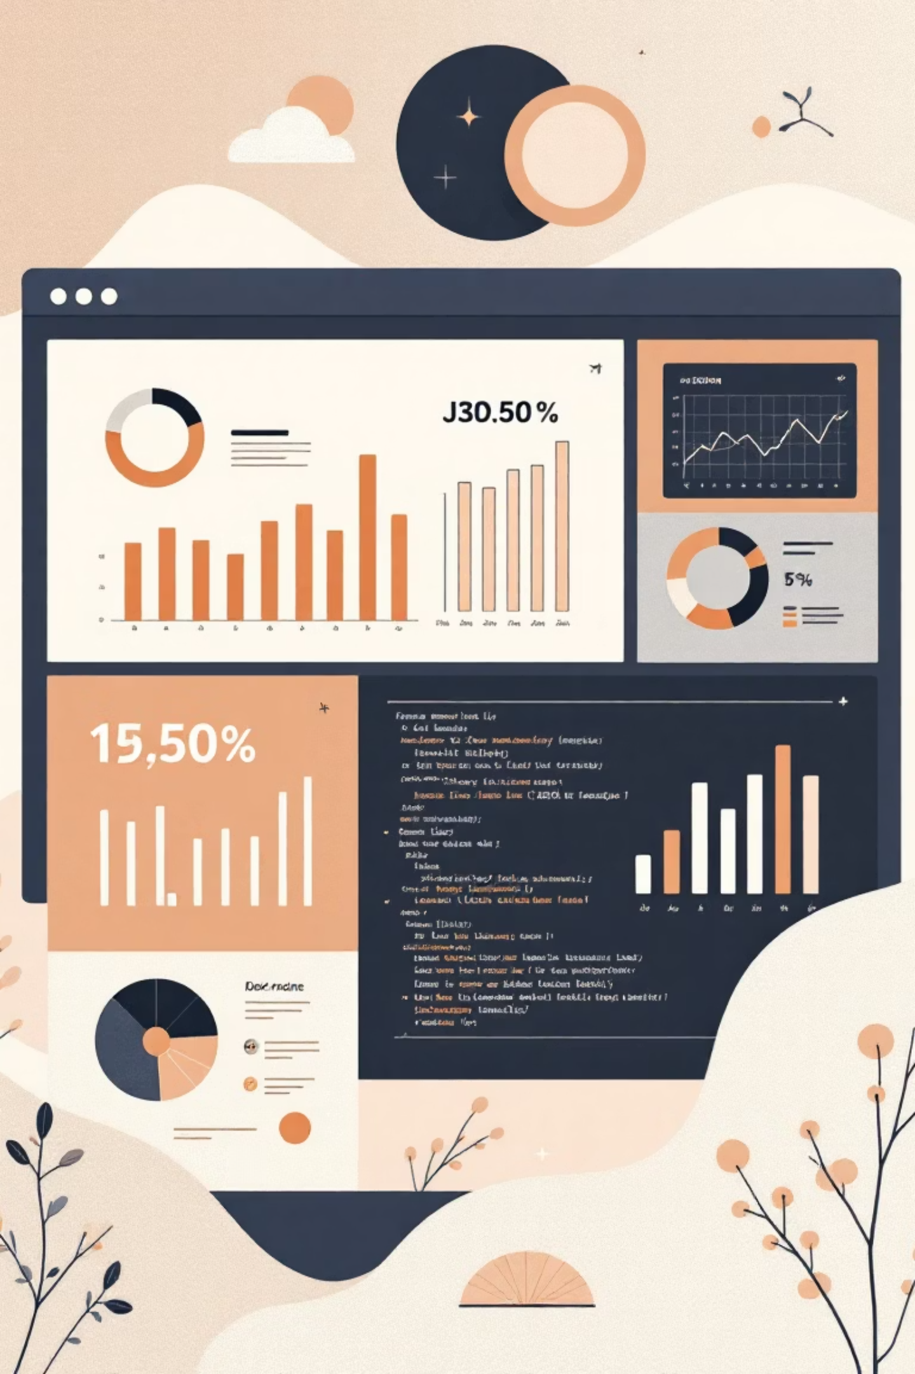
Results & Discussion
System Performance
Sample Output
Video Processing: 30 FPS.
{
"scores": {
"overall_score": 42.2,
"rating": "Below Average"
},
"face_analysis": {
"dominant_emotion": "Fear"
},
"recommendations": [
{
"area": "Eye Contact",
"priority": "High"
}
]
}
Audio Analysis: 3-second chunks in 500ms.
Report Generation: Instant JSON output.
Strengths
Multimodal analysis for robust assessment.
Real-time feedback and actionable recommendations.
Modular architecture, open-source models.
Limitations
Lighting sensitivity, background noise.
Single face, English-dependent speech model.
Hardware requirements.

Slide 19


Conclusion & Future Work
Conclusion
Future Enhancements
AI Interview Analyzer provides objective, quantitative feedback using multimodal emotion recognition, enhancing interview skills.
Body language analysis, NLP, multi-language support, mobile app, cloud deployment, historical tracking, and real-time coaching.

